Slide 1
Excel Lesson 5 Using Functions
Microsoft Office 2010 Introductory
Pasewark & Pasewark

Slide 2
Objectives
Identify the parts of a function.
Enter formulas with functions.
Use functions to solve mathematical problems.
Use functions to solve statistical problems.
Use functions to solve financial problems.
2
2

Slide 3
Objectives (continued)
Use logical functions to make decisions with worksheet data.
Use functions to insert times and dates in a worksheet.
Use text functions to format and display cell contents.
3
3

Slide 4
Vocabulary
argument
date and time functions
financial functions
Formula AutoComplete
function
logical functions
mathematical functions
statistical functions
text functions
trigonometric functions
4
4

Slide 5
What Are Functions?
A function is a shorthand way to write an equation that performs a calculation.
A formula with a function has three parts:
The equal sign identifies the cell contents as a formula.
The function name identifies the operation to be performed.
The argument is the value the function uses to perform a calculation.
5
5

Slide 6
What Are Functions? (continued)
Parts of a function

Slide 7
Entering Formulas with Functions
To enter a formula with a function, you need to do the following.
Start the formula with an equal sign.
Select or enter the function you want to use.
Select or enter the arguments.
Enter the completed formula.
To open the Insert Function dialog box, click the Insert Function button on the Formula Bar.
7
7

Slide 8
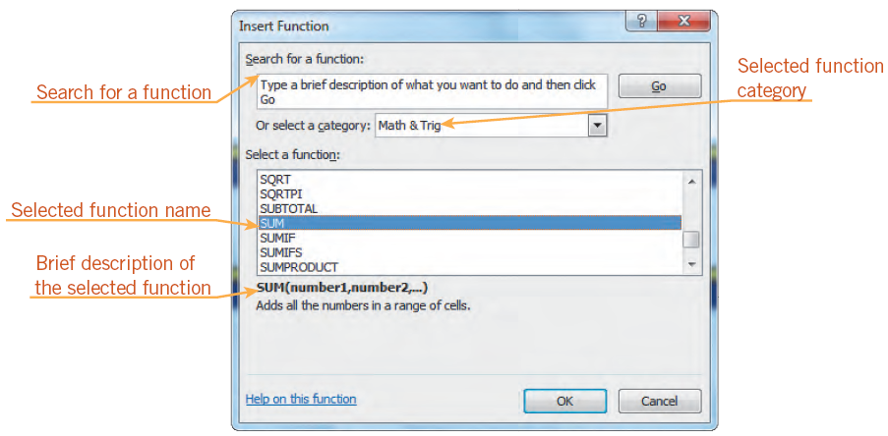
Entering Formulas with Functions (continued)
Insert Function dialog box

Slide 9
Entering Formulas with Functions (continued)
You can also enter a formula with a function directly in a cell by typing an equal sign, the function name, and the argument.
Formula AutoComplete helps you enter a formula with a valid function name and arguments.
As you begin to type the function name, a list of function names appears below the active cell.
9
9

Slide 10
Types of Functions
Mathematical functions and trigonometric functions manipulate quantitative data in a worksheet.
Some mathematical operations, such as addition and subtraction, do not require functions.
Mathematical and trigonometric functions are particularly useful when you need to determine values such as logarithms, factorials, and sines.
10
10

Slide 11
Types of Functions (continued)
Commonly used mathematical and trigonometric functions

Slide 12
Types of Functions (continued)
Statistical functions are used to describe quantities of data.
For example, statistical functions can determine:
the average, standard deviation, or variance of a range of data.
the number of values in a range, the largest value in a range, and the smallest value in a range.
12
12

Slide 13
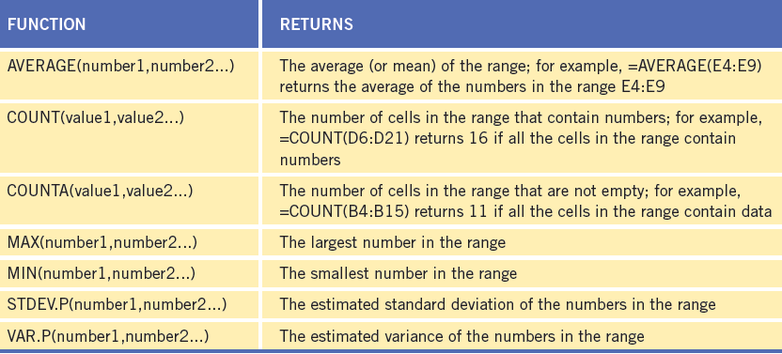
Types of Functions (continued)
Commonly used statistical functions

Slide 14
Types of Functions (continued)
Financial functions are used to analyze loans and investments.
Some commonly used financial functions are future value, present value, and payment.
14
14

Slide 15
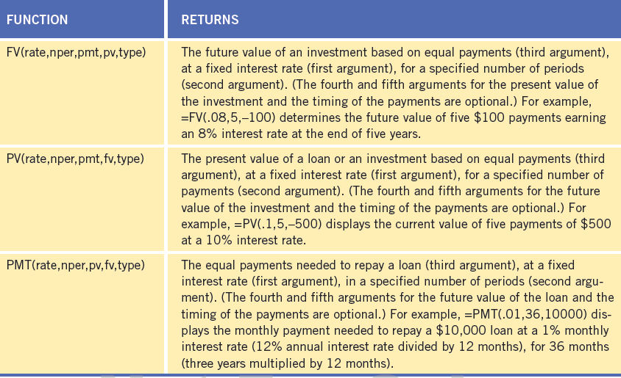
Types of Functions (continued)
Commonly used financial functions

Slide 16
Types of Functions (continued)
Logical functions, such as the IF function, display text or values if certain conditions exist.
The first argument sets a condition for comparison, called a logical test. The second argument determines the value if the logical test is true. The third argument determines the value if the logical test is false.
For example, the formula =IF(C4>60,“PASS”,“FAIL”) returns PASS if the value in cell C4 is greater than 60; otherwise the formula returns FAIL.
16
16

Slide 17
Types of Functions (continued)
Commonly used logical functions

Slide 18
Types of Functions (continued)
Date and Time functions can also be used to insert dates and times in a worksheet.
18
18

Slide 19
Types of Functions (continued)
Text functions are used to format and display cell contents.
19
19

Slide 20
Summary
In this lesson, you learned:
A function is a shorthand way to write an equation that performs a calculation. A formula with a function has three parts: an equal sign, a function name, and for most functions one argument, which acts as an operand.
The best way to select a function is from the Insert Function dialog box. The Function Arguments dialog box provides a description of each argument you enter for the function.
20
20

Slide 21
Summary (continued)
When you type a formula with a function directly in a worksheet cell, Formula AutoComplete helps you enter a formula with a valid function name and arguments.
Functions can be used to perform mathematical, statistical, financial, and logical operations. They can also be used to insert and calculate dates and times and to format text.
21
21

